Slide 1
Introduction to Docker
Basics of building Docker images, sharing them using image registries, orchestrating systems with Docker, and much more.
PRESENTED BY:
Sergey Tantsyura
Maxim Nakhod
Date: October 17, 2019

Slide 2
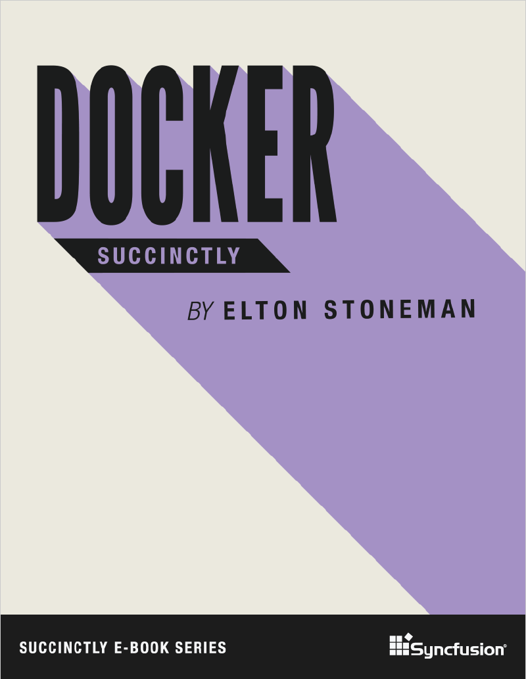
Disclaimer
Content of this training is based on Docker Succinctly e-book.
Succinctly e-book series is a great way to quickly get familiar with new technologies. These e-books are free and most of them are between 50 and 100 pages.

Slide 3
Agenda
01
02
03
04
05
06
Introducing Docker
Creating Docker images
Image registries and Docker Hub
Data Storage in Docker
Orchestrating Systems with Docker
Clustering Hosts with Docker Swarm
Notes:
01, 03, 05, 07 (??????????????????????) – STA
02, 04, 06 – MN
Samples:
01
run SQL server Linux container
Run some windows container
02
create ASP.NET Core app and package it into container
Multi-stage build, first stage builds from sources, second stage packages output of first stage
03 – push created image to image registry, show script
MN to provide link to registry + set access rights
04
add logging, show how to mount folder where logs will be written to.
??? – use folder for DB files in SQL server
05
Start SQL + web app simultaneously, pass connection string to sql server via env variable
+ update web app to use data from DB
06
Run apps from 05 in Docker Swarm
07
??????????????????????????????????????? Kubernetes

Slide 4
Introducing Docker

Slide 5
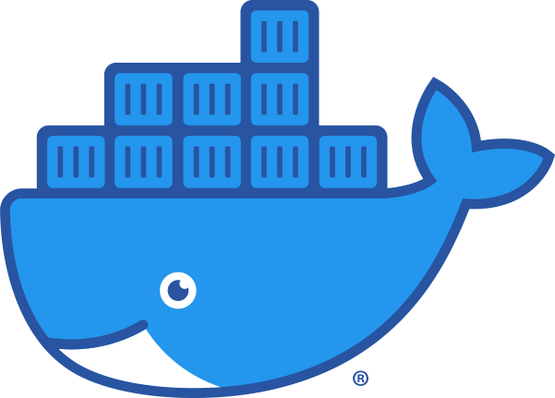
What is Docker?
Docker is an application platform. It lets you package your application with everything it needs, from the operating system upwards, into a single unit that you can share and run on any computer that has Docker. Docker runs your application in a lightweight, isolated component called a container.

Slide 6
Advantages of Docker
The application package, called a Docker image, is typically only tens or hundreds of megabytes, so it’s cheap to store and fast to move.
When you run a container from the image, it will start in seconds and the application process actually runs on the host, which means you can run hundreds of containers on a single machine.
Images can be versioned, so you can be sure the software you release to production is exactly what you’ve tested.
With Docker, you can build your application image and know that it will run in the same way on your development laptop, on a VM in an on-premise test lab, or on a cluster of machines in the cloud.

Slide 7
Advantages of Docker
Docker is open source and cross-platform, and one of its ecosystem’s most compelling aspects is the Docker Hub—a public registry where organizations and individuals share their own application container images.
In Docker, the packaging process is where development and operations meet, which means it’s a great start for the transition to DevOps. And having a framework for orchestrating work between many containers gives you the foundation for microservice architectures.

Slide 8
Installing Docker
Docker is a single product which has three components:
Background server that does the work;
Docker client, a command-line interface for working with the server;
REST API for client-server communication.
The client is cross-platform, which means you can run it natively from Linux, Windows, and OS/X machines, and you can manage Docker running locally or on a remote machine.
The Docker server runs on Linux and on the latest versions of Windows.

Slide 9
Installing Docker
The Docker team has put together packages for Mac and Windows that make use of virtualization technology on the host so that your Docker server runs inside a Linux VM on your OS/X or Windows machine (you run the client locally and talk to the server through the REST API exposed on the VM).
On Windows, you’ll need to have Hardware Virtualization (VT-x) enabled in the BIOS to run the Docker Linux VM, and after installing you’ll need to reboot.
You can switch between Windows containers and Linux containers

Slide 10
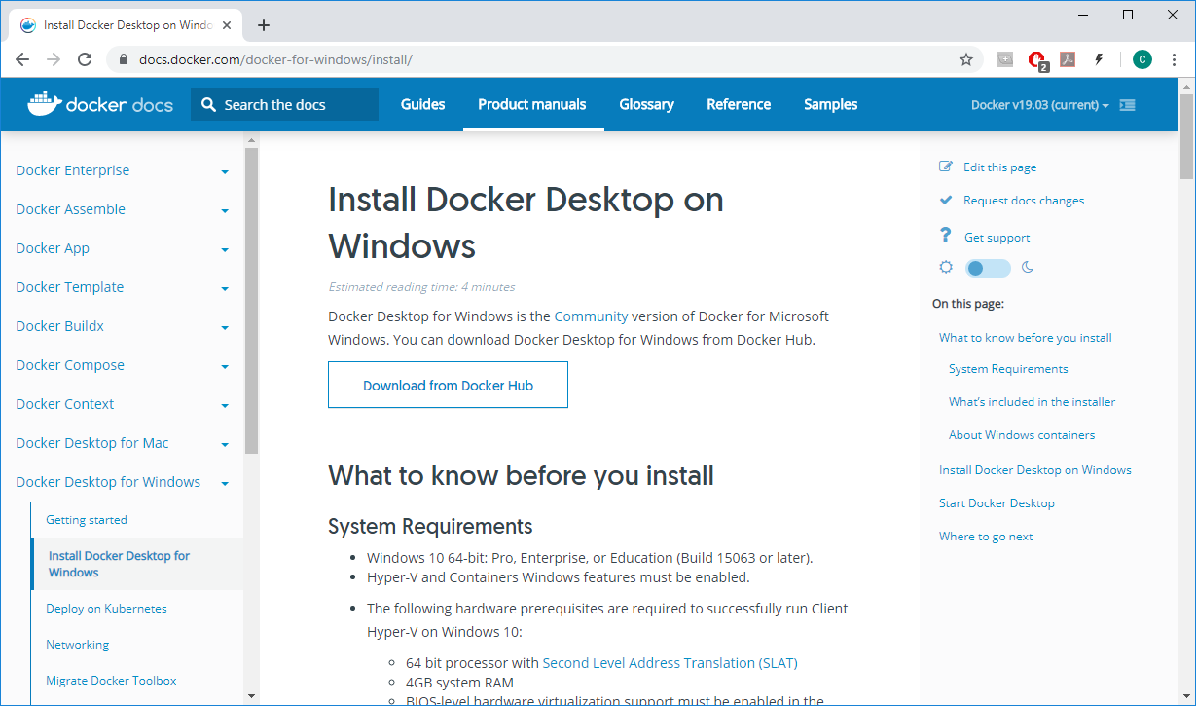
Installing Docker

Slide 11
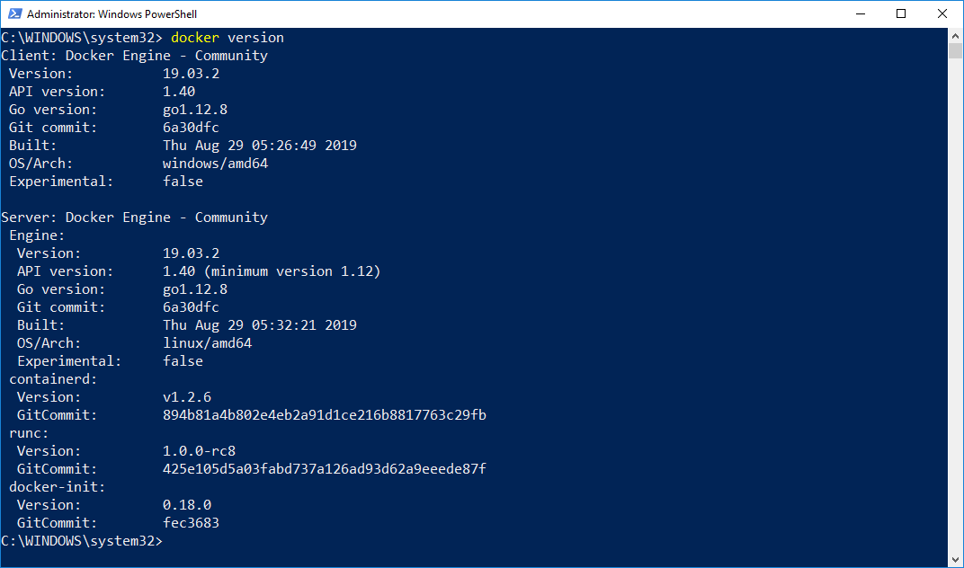
Installing Docker
After Docker Desktop is installed, try running docker version command

Slide 12
Running containers
Docker images are packaged applications. You can push them to a central store (called a registry) and pull them on any machine that has access to the registry. The image is a single logical unit that contains the application package. In order to start the app, you run a container from the image.
Images are typically built to run a single process. If your app needs to work with other services, you run those services in their own containers and orchestrate them so that all the containers can work together
When you run a container from an image, it may be a short-lived app that runs some functionality and then ends; it may be a long-running app that runs like a background service; or it may be an interactive container that you can connect with as though it was a remote machine.

Slide 13
Running containers
DEMO
Notes:
Sample commands can be found in src/01_Introducing_Docker
When connecting to SQL Server using SQL Server Management Studio, specify “localhost,14330” as server name
Show switching from Linux containers to Windows containers, show output of “docker version” command after switching.
Mention requirement to install updates to be able to run Windows containers. Show output of “docker version” command, it includes system architecture.

Slide 14
Creating Docker images

Slide 15
Header
Content

Slide 16
Image registries and Docker Hub

Slide 17
Header
Content

Slide 18
Data Storage in Docker

Slide 19
Header
Content

Slide 20
Orchestrating Systems with Docker

Slide 21
Header
Content

Slide 22
Clustering Hosts with Docker Swarm

Slide 23
Header
Content

Slide 24
Q&A

